Slide 1
SHOOT THE CAR

Slide 2
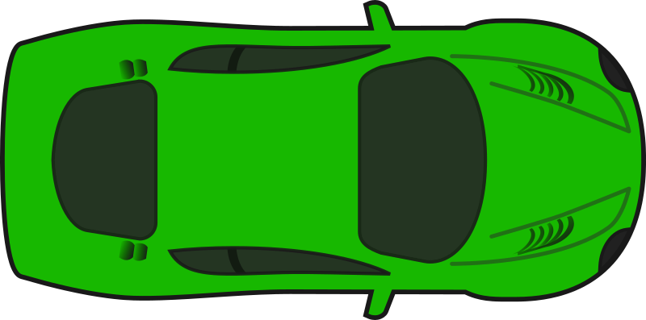

Slide 3
YOU LOSE
PLAY AGAIN

Slide 4
YOU WIN
PLAY AGAIN

